Slide 1
Assessing habitat and cavity preferences of Red-cockaded Woodpeckers on the Croatan National Forest
Tani Valdez Rivas

Slide 2
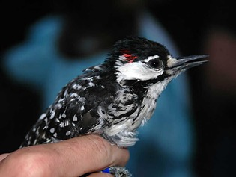
Background
Scientific Name: Dryobates borealis
Habitat Distribution: Southeastern United States, primarily in Longleaf pine savannas
Live in clusters of 1 to 20 or more trees
Breeding: April through June
Lifespan: Possibly 16 years
Diet: Arthropods (ants and cockroaches) beetles, spiders, centipedes, true bugs, crickets, and moths
Predators: North American rat snakes, arboreal snakes, flying squirrels, and larger birds
Estimated population: 19,000 birds or 7,800 clusters
Federal status: Endangered
Source: https://www.usgs.gov/media/images/red-cockaded-woodpecker
Notes:
Clutch Size: 2-5 eggs
Incubation Period: 10-11 days
Nestling Period: 26-29 days
Resin is hypothesized to deter predators
Why is this important: they are keystone and indicator species
Highly territorial and non-migratory
Population is 3% of what it used to be
Explain term: cooperative breeding system
Foraging habitat generally consists of mature pines with an open canopy, low densities of small pines, a sparse hardwood and/or pine midstory, few or no overstory hardwoods, and abundant native bunchgrass and forb groundcovers.

Slide 3
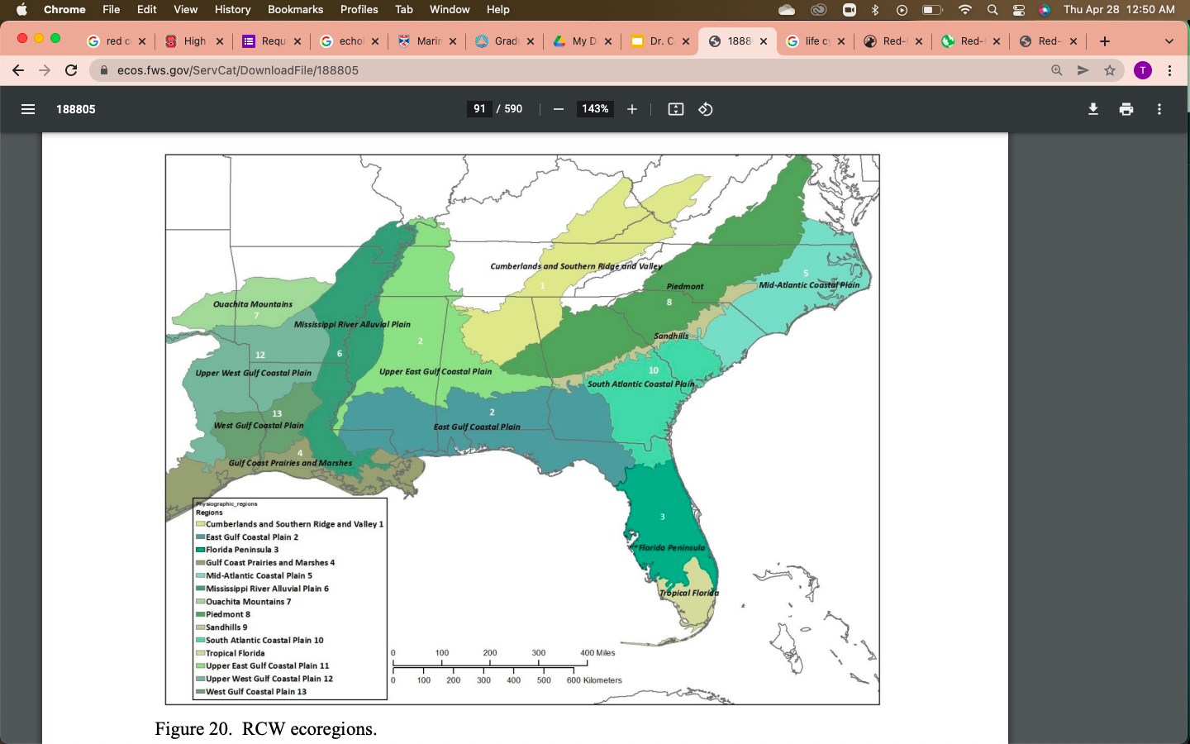
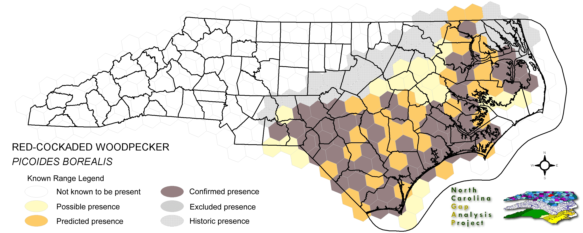
Habitat range
Source: http://www.basic.ncsu.edu/ncgap/sppreport/abnyf07060.html
Source: Species Status Assessment Report For the Red-cockaded Woodpecker (Picoides borealis)
Notes:
Causes of decline: agriculture and timber harvest
Foraging habitat generally consists of mature pines with an open canopy, low densities of small pines, a sparse hardwood and/or pine midstory, few or no overstory hardwoods, and abundant native bunchgrass and forb groundcovers.

Slide 4
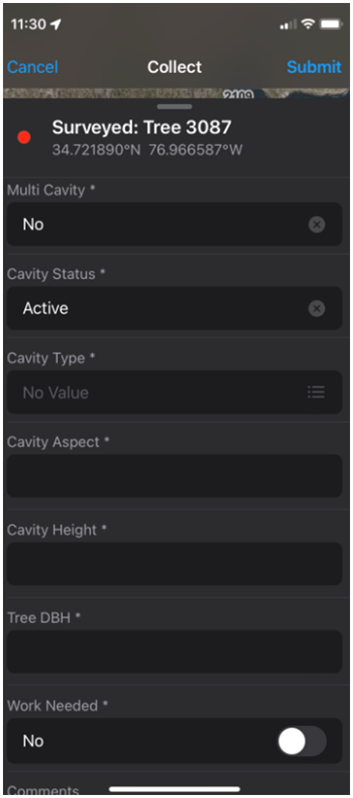
Methods
Surveyed cavity trees and recorded data using ArcGIS Field Maps from January to July
Determine if the cavity is inactive or active
Measure diameter at breast height
Measure cavity height
Measure cavity aspect
Identify tree species
Assisted in the development of a presence-only prediction model in ArcGIS Pro to determine areas of suitable habitat for conducting transect surveys to locate new cavity trees
Age stand
Stand type
Year since prescribed burning
Canopy cover
Notes:
Purpose: compare reference that was in recovery plan and species assessment to what was measured in the field

Slide 5
Results
13% of the cavity trees were active during the 2022 season
70.5% of active cavities were natural cavities

Slide 6
Results
Notes:
Preferred cavity heights generally range from 20 to 50 ft
My data:
avg height – 23.8 ft
SD – 10.8
Reported sizes below which trees are avoided (that is, used less than their availability): 5 inches to 10 inches in NC costal plain and sandhills
Reported sizes above which trees are selected (used more than their availability): 10 inches in costal NC, 12 inches in NC sandhills
Use tree diameter to determine age as many RCW prefer trees older than 60 years because
need sufficient heartwood diameter at preferred cavity heights to construct the cavity completely within the heartwood
old pines have a higher frequency of infection by red heart fungus which softens hardwood

Slide 7
Results

Slide 8
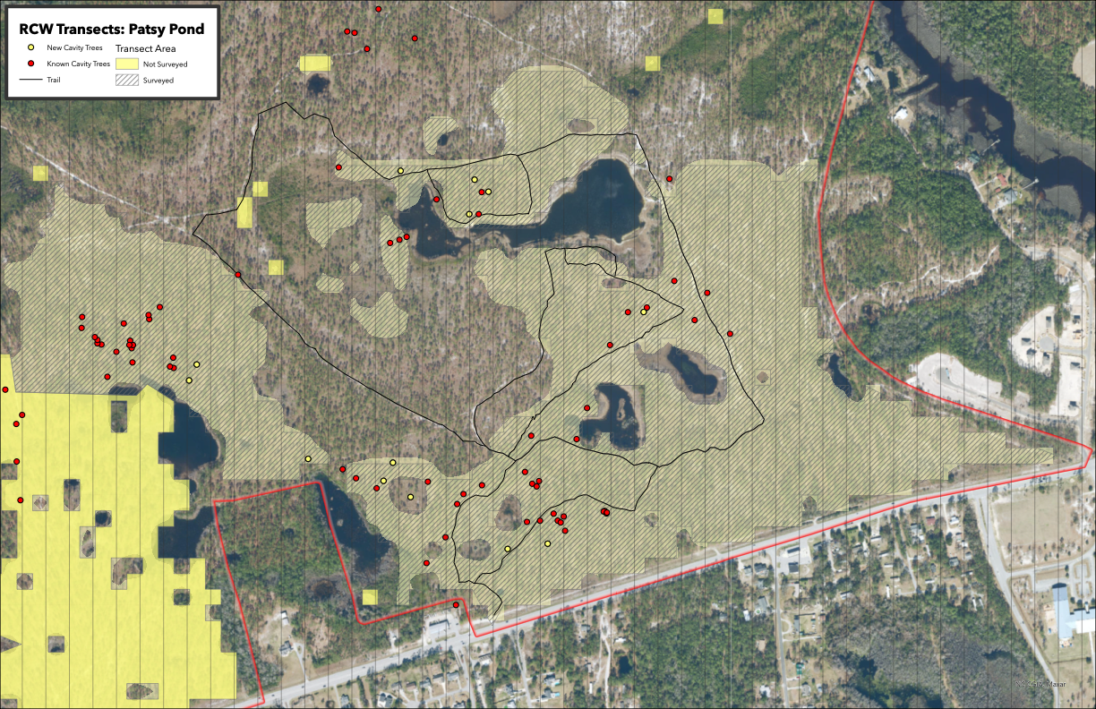
Presence-only model
Discovered 10 new cavity trees in the Patsy Pond area
Notes:
Why did we choose Patsy Pond specially? Accessible and the best example of a pine savannah within the Croatan Forest
Transects are run north-south, because many cavity entrances are oriented in a westerly direction

Slide 9
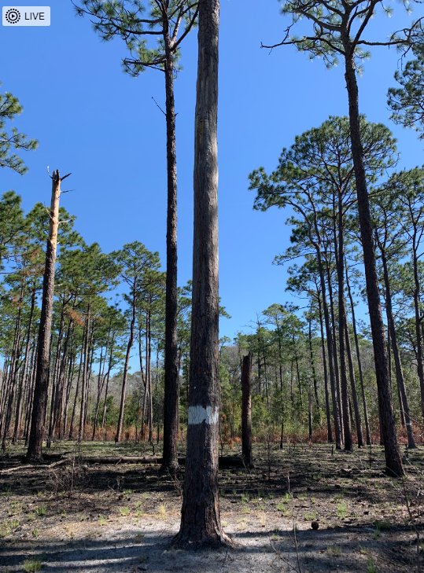
Conclusion
We found RCWs prefer to occupy natural, west-facing cavities in longleaf pine trees
Cavity height preference ranged from 10-35 feet
Over 45% of surveyed cavities were inactive, 13% were active and 42% were undetermined, unknown or unsuitable
The spatial model predicted areas of suitable habitats that will be continued to be ground-truthed
Ten new cavity trees were discovered
Data from this research project will be directly utilized in 2023 by resource managers to inform timber harvest plans and prescribed burning priorities

Slide 10
References
Conner, R. N., & Locke, B. A. (1979). Effects of a Prescribed Burn on Cavity Trees of Red-Cockaded Woodpeckers. Wildlife Society Bulletin (1973-2006), 7(4), 291–293.
Conner, R. N., Shackelford, C. E., Schaefer, R. R., Saenz, D., & Rudolph, D. C. (2002). Avian Community Response to Southern Pine Ecosystem Restoration for Red-Cockaded Woodpeckers. The Wilson Bulletin, 114(3), 324–332
James, F.C., Hess, C.A., Kicklighter, B.C., & Thum, R.A. (2001). Ecosystem Management and the Niche Gestalt of the Red-Cockaded Woodpecker in Longleaf Pine Forest. Ecological Applications, 11, 854-870.
Rudolph, D. C., Conner, R. N., & Schaefer, R. R. (2002). Red-Cockaded Woodpecker Foraging Behavior in Relation to Midstory Vegetation. The Wilson Bulletin, 114(2), 235–242.
U.S. Fish and Wildlife Service. Southeast Region. (2003). Recovery Plan for the Red-cockaded Woodpecker (Picoides borealis). Atlanta, GA: The Region.
U.S. Forest Service: Southern Region. (2002). Revised Land and Resource Management Plan for the Croatan National Forest. Atlanta, GA: The Region.
U.S. Forest Service: Southern Region. (2020). Biennial Monitoring Evaluation Report for the Uwharrie and Croatan National Forests.
Wilson, C. W., Masters, R. E., & Bukenhofer, G. A. (1995). Breeding Bird Response to Pine-Grassland Community Restoration for Red-Cockaded Woodpeckers. The Journal of Wildlife Management, 59(1), 56–67.

Slide 11



Acknowledgments
Special thanks to Kathleen Mahoney, Kelli Applegate, Blake Smith, and Dr. Carol Price

Slide 12
